Slide 1
Lecture 7
Simulation of a Telephone System

Slide 2
Objectives
Process a given number of calls and determine what proportions are
successfully completed
blocked or
found to be busy calls

Slide 3
Objectives
The system has a number of telephones (6 are shown) connected to a switchboard by lines.
The switchboard has a number of links which can be used to connect any two lines, subject to the condition that only one connection at a time can be made to each line.
The system is lost call system.
i) A call is lost, if the called party is engaged, then it is a busy call.
ii) A call may be lost if no link is available, it is blocked call.

Slide 4
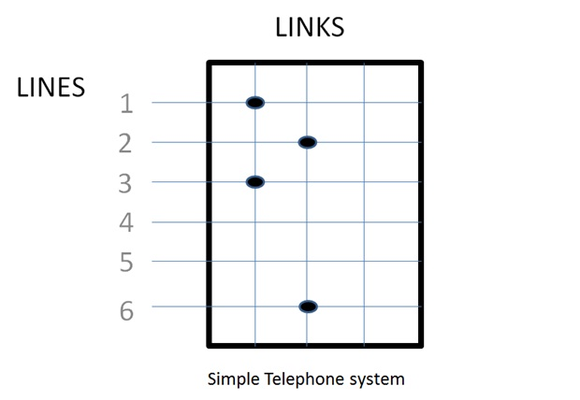

LINES

Slide 5
Situation
Each call is a separate entity having attributes
a) Source
b) Destination
c) Length, and
d) the time at which call finished
0 represents Free
1 represents Busy
To keep track of event, a number representing clock time is included. At present 1035(time unit)
To generate the arrival of call, a record is kept of the time the next call is due to arrive.
The set of numbers within the main box of figure records the state of the system at time 1035.
There are two activities causing events:
i) New calls arrive
ii) Existing calls vanish
Maximum link 3 and 2 is in use

Slide 6
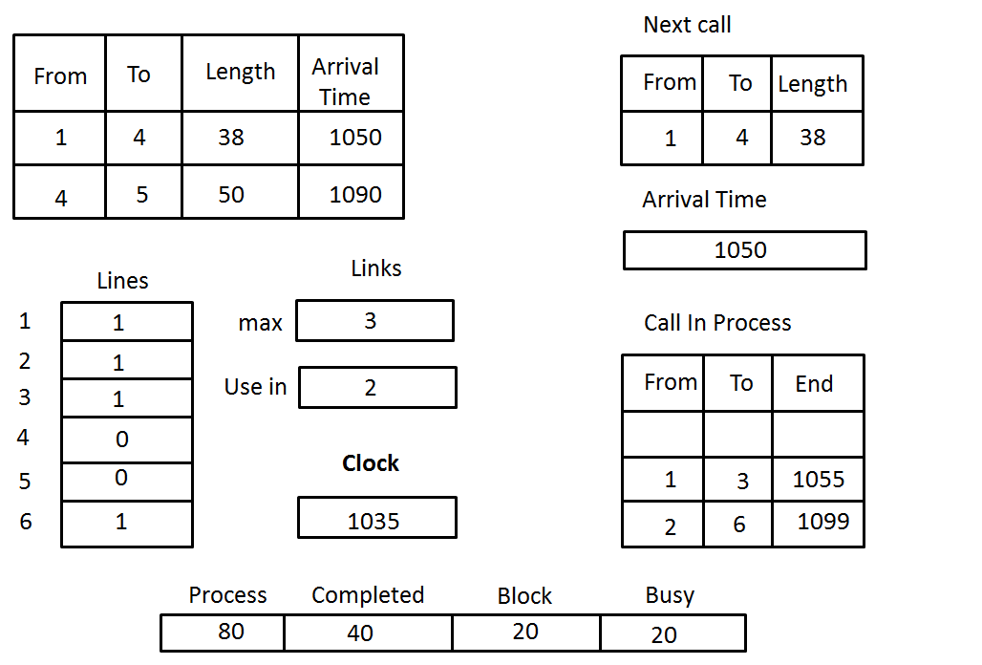
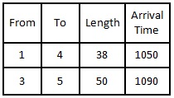

Slide 7


2

Slide 8
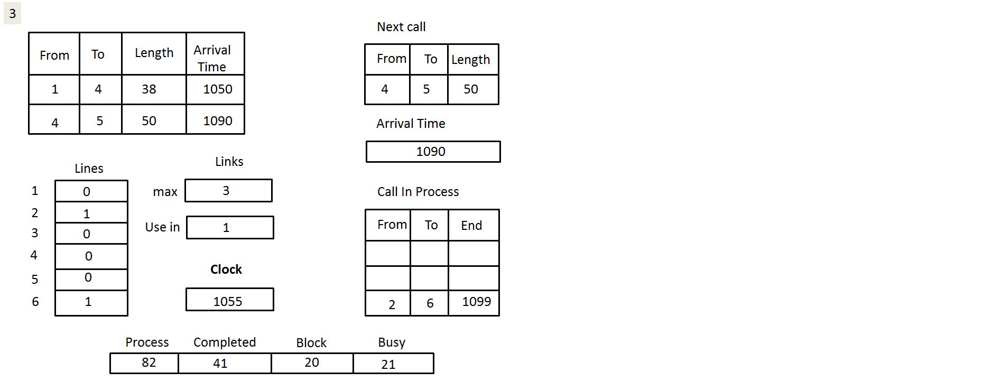

Slide 9
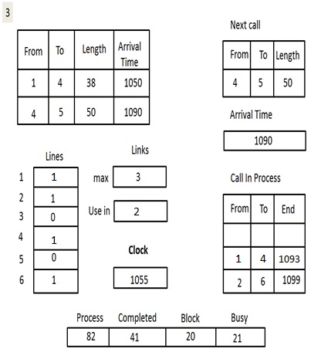

Slide 10
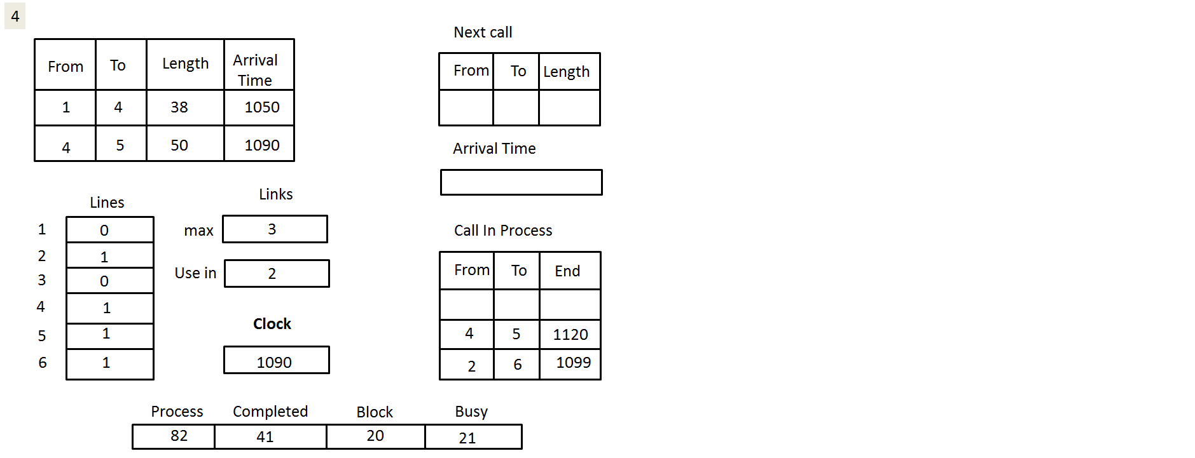

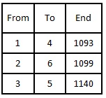

1140

Slide 11

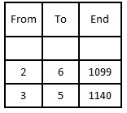



Slide 12
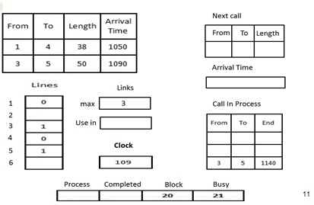
0
1
0
1099
84
43

Slide 13
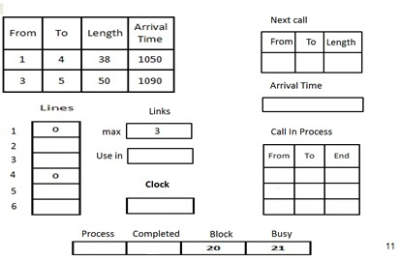
0
0
0
0
0
1140
85
44

Slide 14
Termination of simulation
After processing a given number of calls, or
Until a certain time has elapsed.

Slide 15
THANK YOU

